Slide 1
More SQL SELECT

Slide 2
This Lecture
Aliases and ‘Self-joins’
More WHERE Clauses
Subqueries
IN, EXISTS, ANY, ALL
LIKE
ORDER BY

Slide 3
Aliases
Aliases rename columns or tables
Can make names more meaningful
Can shorten names, making them easier to use
Can resolve ambigious names
Two forms:
Column alias
SELECT column [AS] new- col-name
Table alias
SELECT * FROM table new- table-name
([] optional)

Slide 4
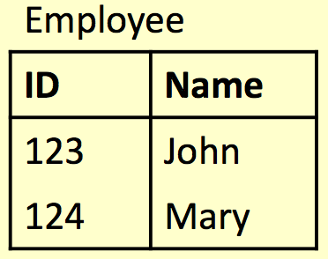
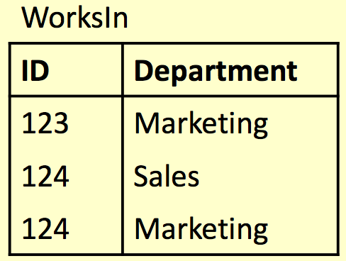
Alias Example
SELECT
E.ID AS empID,
E.Name, W.Department FROM
Employee E,
WorksIn W WHERE
E.ID = W.ID;

Slide 5
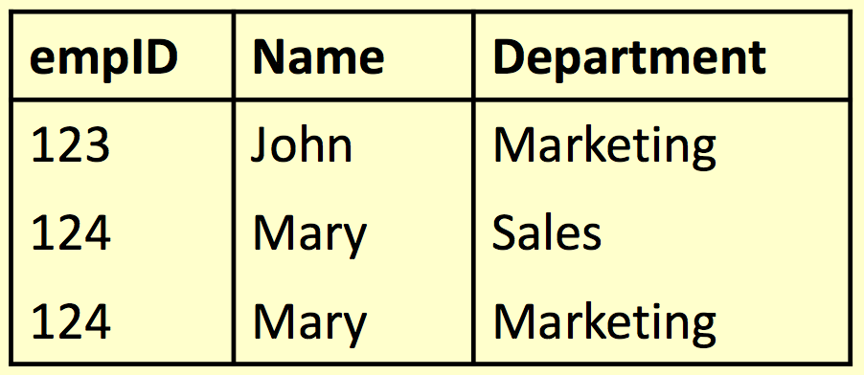
Alias Example
SELECT
E.ID AS empID,
E.Name, W.Department FROM
Employee E, WorksIn W
WHERE
E.ID = W.ID;

Slide 6
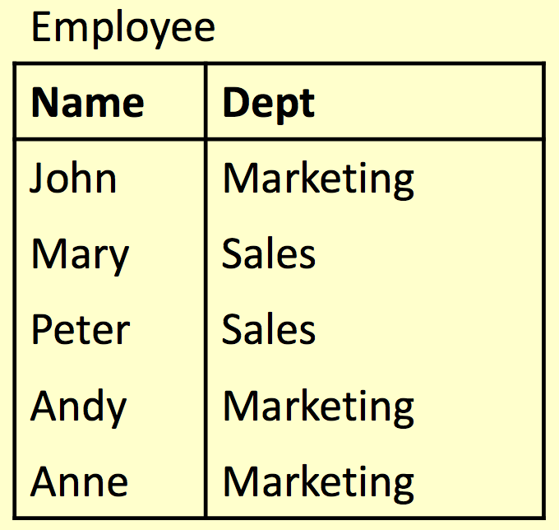
Aliases and ‘Self-Joins’
Aliases can be used to copy a table, so that it can be combined with itself
Example: Find the names of all employees who work in the same department as Andy

Slide 7
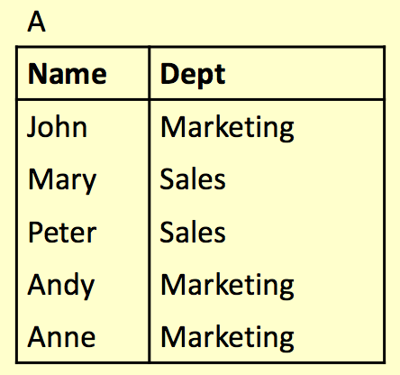
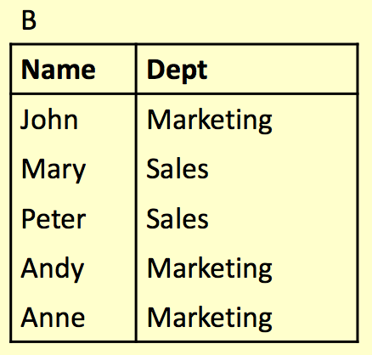
Aliases and ‘Self-Joins’
Employee A Employee B

Slide 8
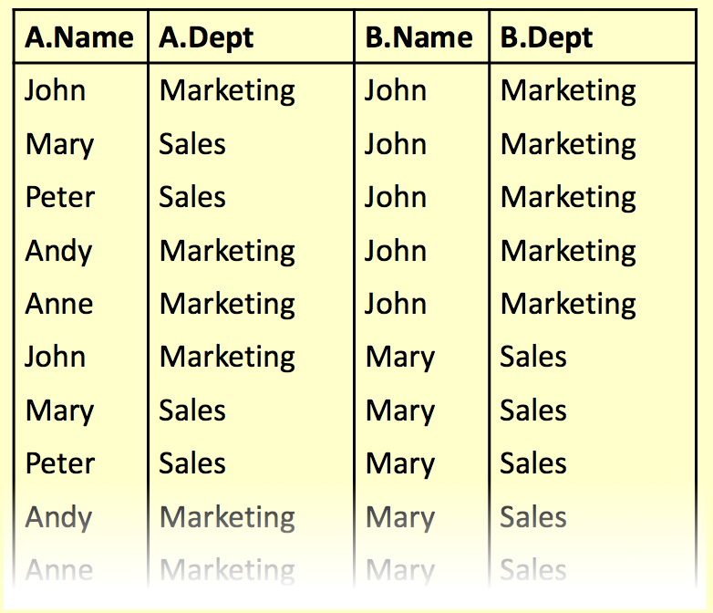
Aliases and ‘Self-Joins’
SELECT ... FROM Employee A, Employee B ...

Slide 9
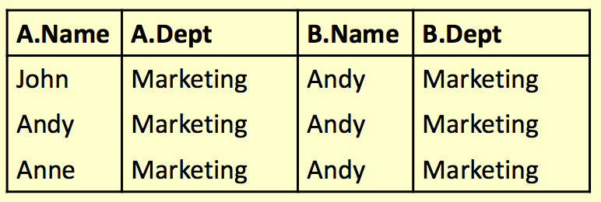
Aliases and ‘Self-Joins’
SELECT ... FROM Employee A, Employee B
WHERE A.Dept = B.Dept AND B.Name = ‘Andy’;

Slide 10
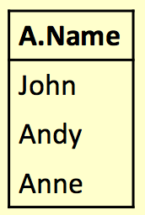
Aliases and ‘Self-Joins’
SELECT A.Name FROM Employee A, Employee B WHERE A.Dept = B.Dept AND B.Name = ‘Andy’;
Names of all employees who work in the same department as Andy

Slide 11
The SQL WHERE Clause
The WHERE clause is used to extract only those records that fulﬁll a speciﬁed criterion
WHERE Syntax
SELECT column_name, column_name
FROM table_name
WHERE column_name operator value;

Slide 12
Operators in The WHERE Clause
= | Equal
<> | Not equal. Note: In some versions of SQL this operator may be written as !=
> | Greater than
< | Less than
>= | Greater than or equal
<= | Less than or equal
BETWEEN | Between an inclusive range
IN | To specify multiple possible values for a column
LIKE | Search for a pattern

Slide 13
Subqueries
A SELECT statement can be nested inside another query to form a subquery
The results of the subquery are passed back to the containing query
For example, retrieve a list of names of people who are in Andy’s department:
SELECT Name FROM Employee
WHERE Dept = (SELECT Dept
FROM Employee WHERE Name=‘Andy’);

Slide 14
Subqueries
SELECT Name FROM Employee WHERE Dept = (SELECT Dept
FROM Employee WHERE
Name=‘Andy’);
First the subquery is evaluated returning ‘Marketing’
This value is passed to the main query:
SELECT Name FROM Employee WHERE Dept = ‘Marketing’);

Slide 15
Subqueries
Onen a subquery will return a set of values rather than a single value
We cannot directly compare a single value to a set. Doing so will result in an error
Options for handling sets:
IN – checks to see if a value in a set
EXISTS – checks to see if a set is empty
ALL/ANY – checks to see if a relationship holds for every/one member of a set
NOT can be used with any of the above

Slide 16
IN
Using IN we can see if a given value is in a set of values
NOT IN checks to see if a given a value is not in the set
The set can be given explicitly or can be produced in a subquery
SELECT columns FROM tables WHERE value
IN set;
SELECT columns FROM tables WHERE value
NOT IN set;

Slide 17
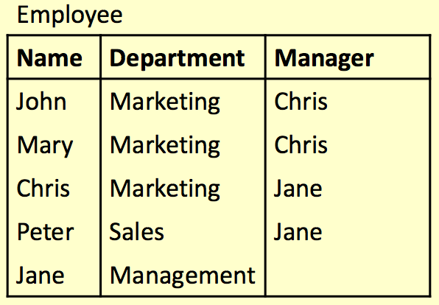
IN
SELECT *
FROM Employee WHERE Department
IN
(‘Marketing’, ‘Sales’);

Slide 18
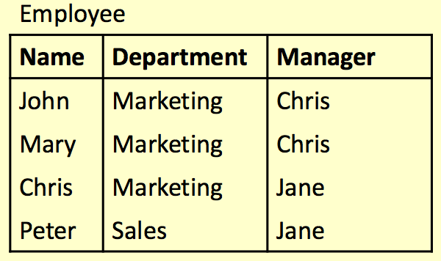
IN
SELECT *
FROM Employee WHERE Department
IN
(‘Marketing’, ‘Sales’);

Slide 19
NOT IN
SELECT *
FROM Employee WHERE Name
NOT IN
(‘Chris’, ‘Jane’);

Slide 20
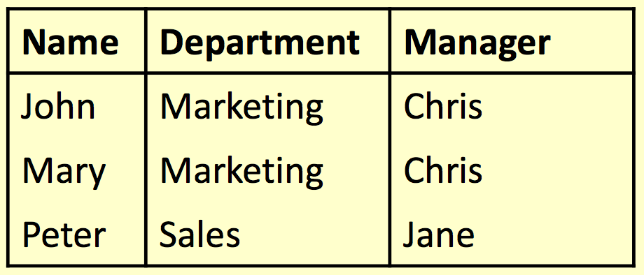
NOT IN
SELECT *
FROM Employee WHERE Name
NOT IN
(‘Chris’, ‘Jane’);

Slide 21
EXISTS
Using EXISTS we can see whether there is at least one element in a given set
NOT EXISTS is true if the set is empty
The set is always given by a subquery
SELECT columns FROM tables WHERE EXISTS set;
SELECT columns FROM tables WHERE
NOT EXISTS set;

Slide 22
EXISTS
SELECT *
FROM Employee AS E1 WHERE EXISTS (
SELECT * FROM
Employee AS E2
WHERE E1.Name =
E2.Manager);
Retrieve all the info for those employees who are also managers.

Slide 23
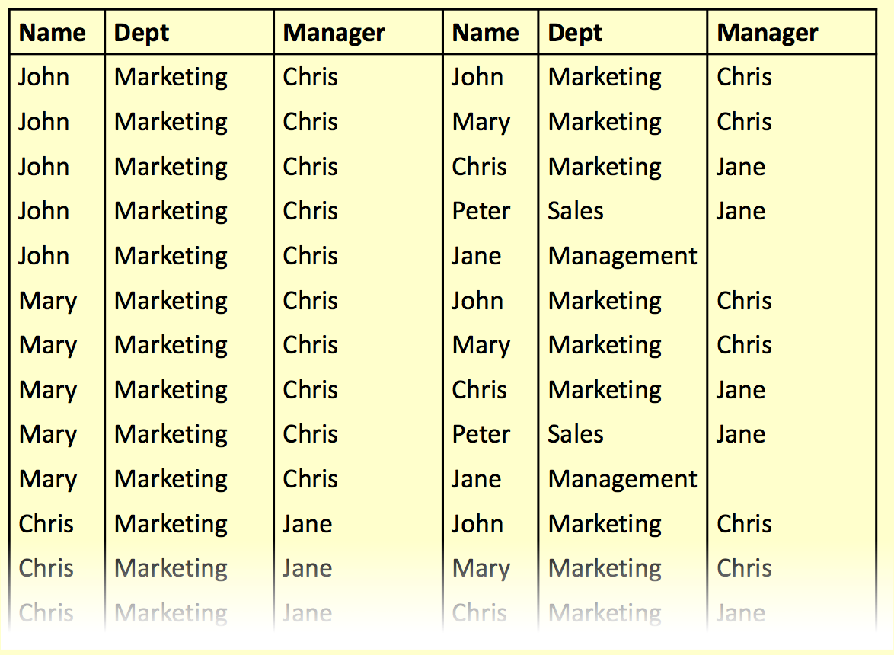
EXISTS

Slide 24
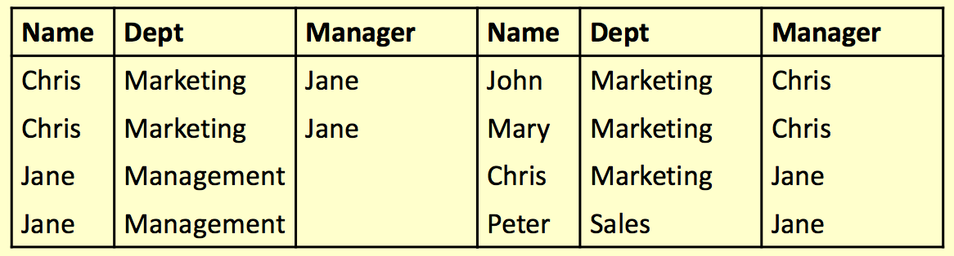
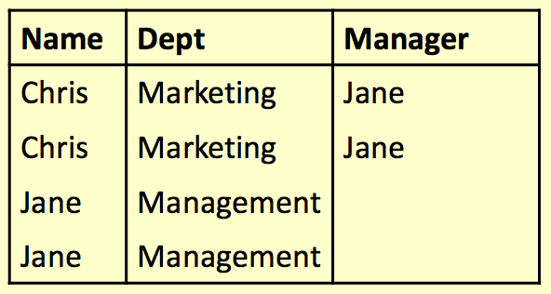
EXISTS
SELECT * FROM Employee AS E1 WHERE EXISTS
(SELECT * FROM Employee AS E2 WHERE E1.Name = E2.Manager);

Slide 25
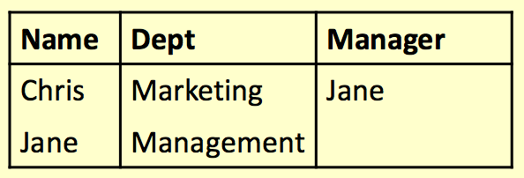
EXISTS
SELECT *
FROM Employee AS E1 WHERE EXISTS (
SELECT * FROM
Employee AS E2
WHERE E1.Name =
E2.Manager);

Slide 26
ANY and ALL
ANY and ALL compare • val = ANY(set) is true
a single value to a set of values
if there is at least one member of the set equal to value
They are used with
comparison operators• val = ALL(set) is true if
like =, >, <, <>, >=, <=
all members of the set are equal to the value

Slide 27
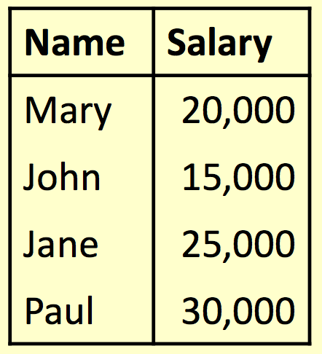
ALL
Find the name(s) of the employee(s) who earn the highest salary

Slide 28
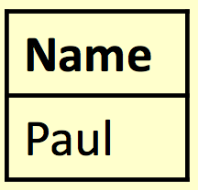
ALL
Find the name(s) of the employee(s) who earn the highest salary
SELECT Name
FROM Employee
WHERE Salary >= ALL (
SELECT Salary FROM Employee);

Slide 29
ANY
Find the name(s) of the employee(s) who earn more than someone else

Slide 30
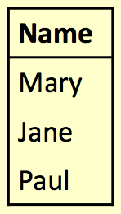
ANY
Find the name(s) of the employee(s) who earn more than someone else
SELECT Name
FROM Employee
WHERE Salary > ANY(
SELECT Salary
FROM Employee);

Slide 31
Word Search
Commonly used for searching product catalogues etc.
Need to search by keywords
Might need to used partial keywords
For example, Given a database of books, search for “crypt” might return
“Cryptonomicon” by Neil Stephenson
“Applied Cryptographer” by Bruce Schneier

Slide 32
LIKE
We can use the LIKE keyword to perform string comparisons in queries
Like is not the as ‘=’ because it allows wildcard characters
It is NOT normally case sensitive
SELECT * FROM books
WHERE bookName LIKE “%crypt%”

Slide 33
LIKE
The ‘%’ character can represent any number of characters, including none
bookName LIKE “crypt%”
The ‘_’ character represents exactly one character
bookName LIKE “cloud_”
Will return “Clouds” but not “Cloud” or “cloud computing”
Will return “Cryptography Engineering” and “Cryptonomicon” but not “Applied Cryptography”

Slide 34
SQL ORDER BY
The ORDER BY keyword is used to sort the result-set by one or more columns.
The ORDER BY keyword sorts the records in ascending order by default. To sort the records in a descending order, you can use the DESC keyword.
SELECT column_name, column_name
FROM table_name
ORDER BY column_name ASC|DESC,
column_name ASC|DESC;

Slide 35
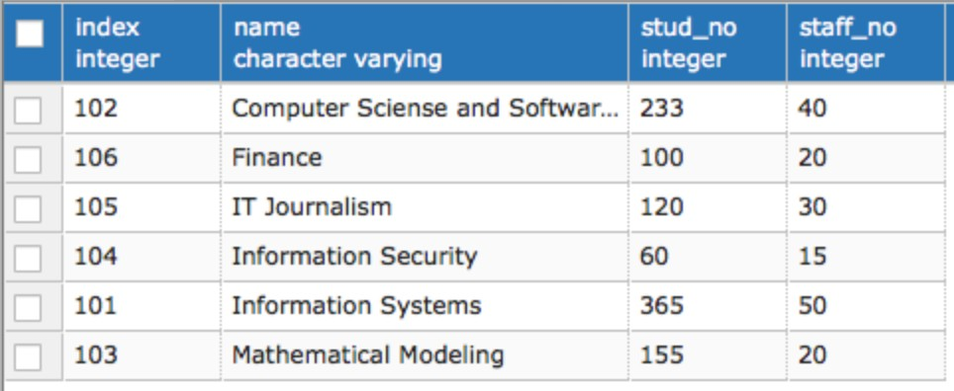
SELECT * FROM DEPARTMENT ORDER BY NAME;

Slide 36
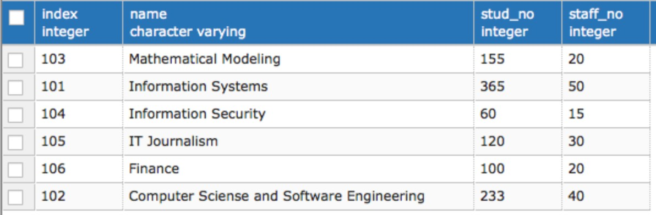
SELECT * FROM DEPARTMENT ORDER BY NAME DESC;

Slide 37
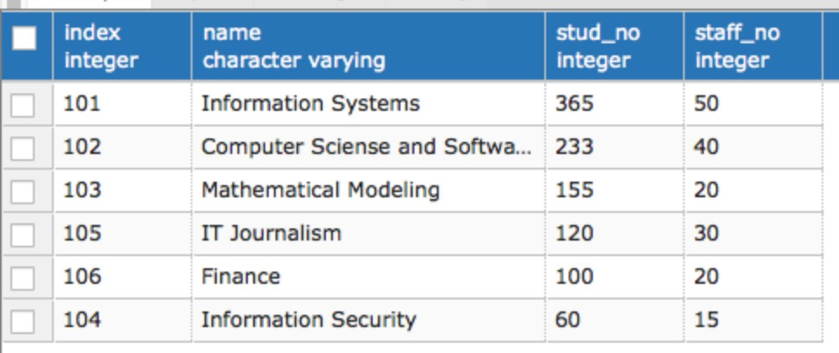
SELECT * FROM DEPARTMENT ORDER BY STUD_NO DESC, NAME;

Slide 38
Thank you for your attention!

